Slide 1
Noise2Void demo

Slide 2
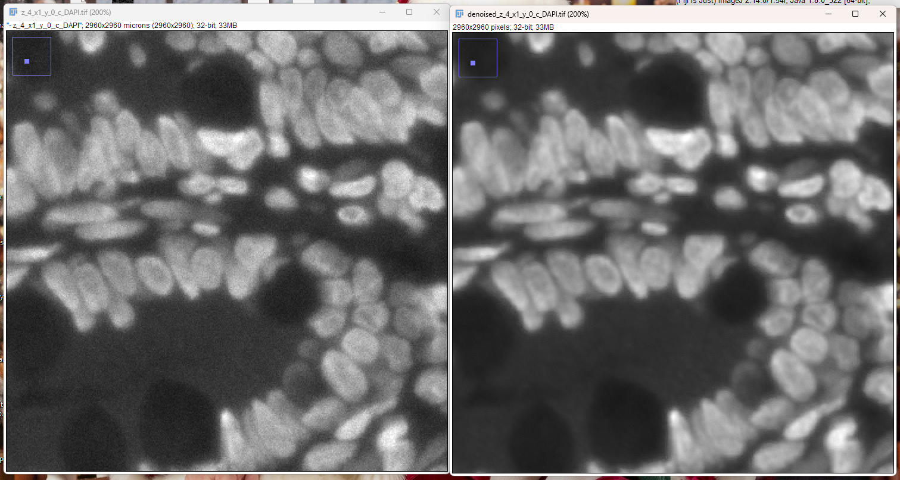
DAPI

Slide 3
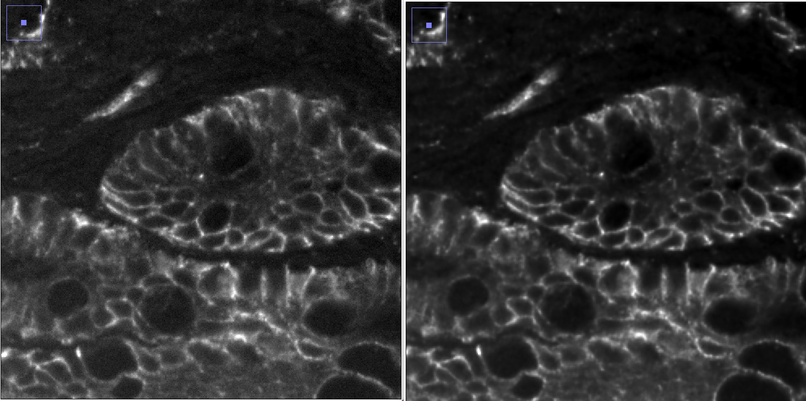
EPCAM

Slide 4
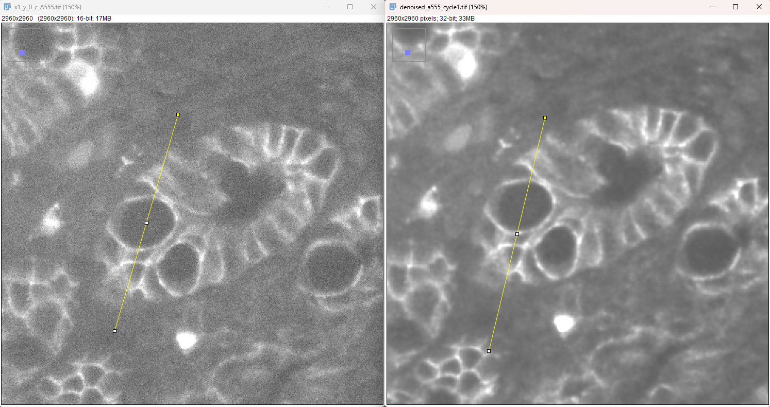

A555_cycle1

